Slide 1

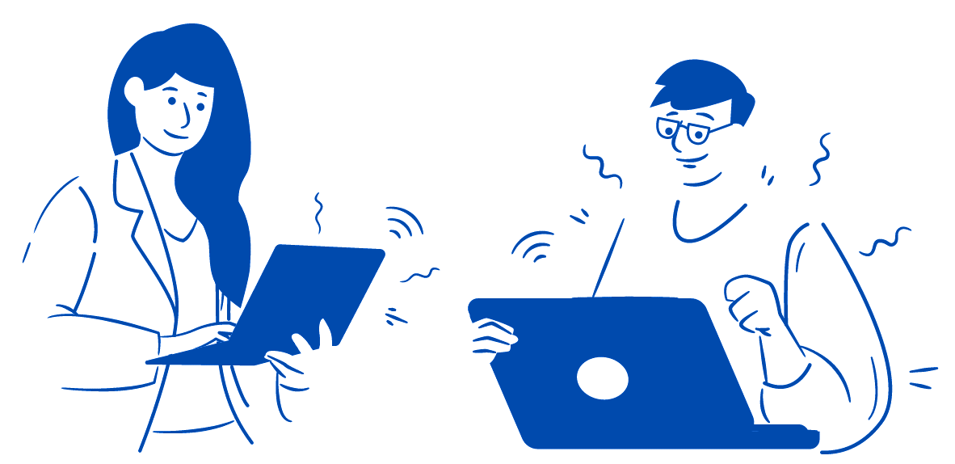

RUHR-UNIVERSITY BOCHUM
ReSeeD Tutorial
Research Data Management System

Slide 2
Contents
What is ReSeeD?
First steps in ReSeeD
Adding a new collection
Add / view / download one of your works
Add a work to a collection
Search ReSeeD for works
Submit your work for publication/ archival review
Optional functions
Contact

Slide 3
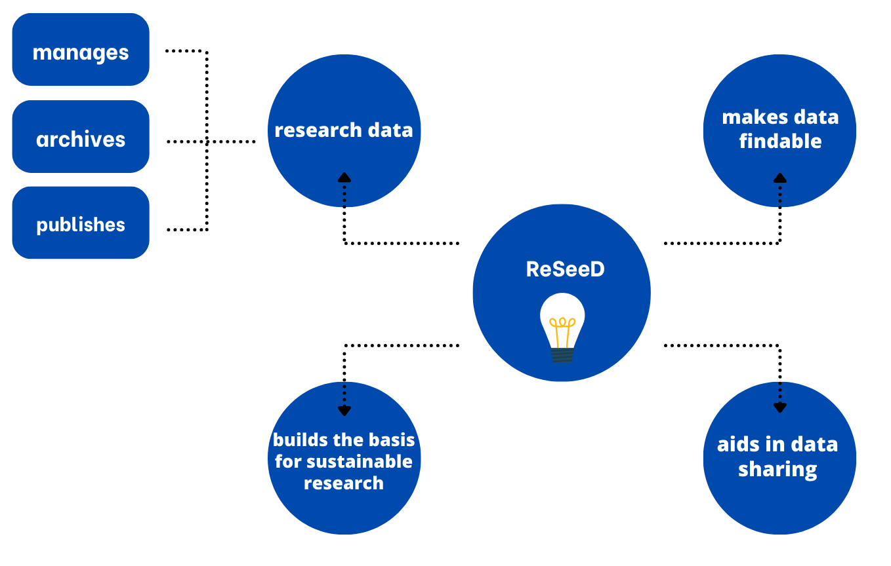
About ReSeeD
  ReSeeD is a central platform of RUB to support sustainable management of the research data in the interests of good scientific practice and the FAIR principles.
  Aim: permanent storage, structuring, and (if desired) publication of research data.

Slide 4
First steps: log in to ReSeeD

Slide 5
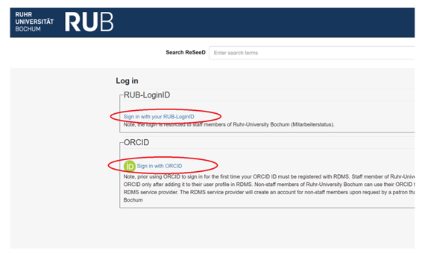
Login via ORCID or RUB LoginID
Click on the “Login” button at the top right of the ReSeeD page.
Are you a RUB staff member?
Yes
No
use your RUB-Login-ID
choose the ORCID-Option
this will redirect you to a Shibboleth login form
this will redirect you to the ORCID login form

Slide 6
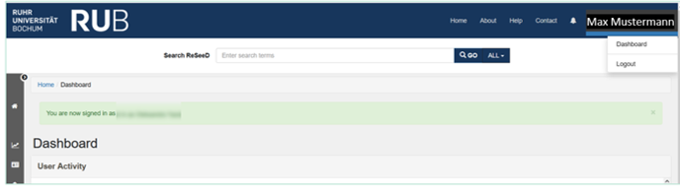
User Dashboard
The User Dashboard is the starting place for newly-authenticated users.
It contains links to various features.
It enables working with your datasets and collections.
Click on your username at the top right of the header.
Choose 'Dashboard' from the drop-down menu.

Slide 7
Adding a new collection

Slide 8
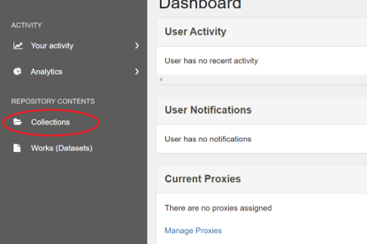
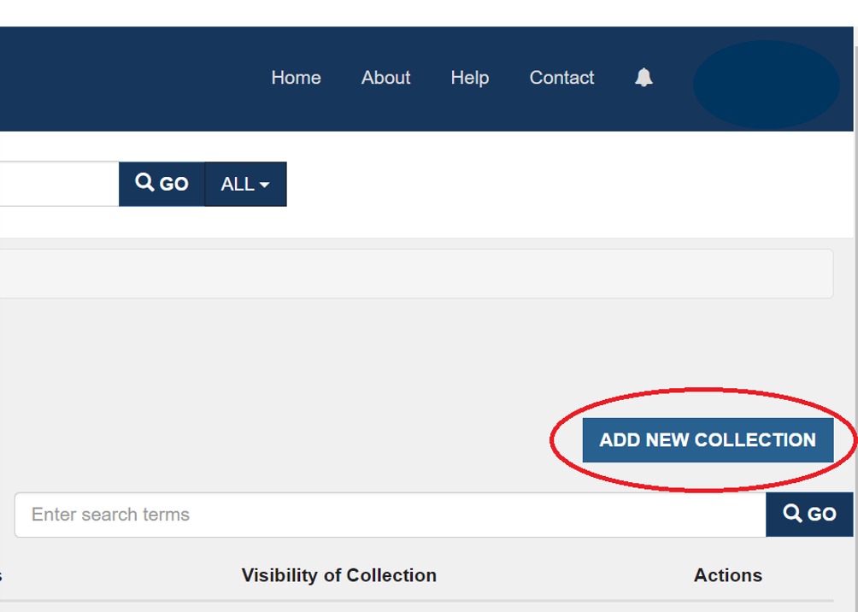
Adding a new collection
Click “Collections” on your user dashboard on the left.
Click “ADD A NEW COLLECTION“ in the grey sidebar on the right.
Fill in the “New User Collection” form.
Click the black button “ADDITIONAL FIELDS” to add additional metadata to your new collection.
When you are finished, click the blue “SAVE” button.

Slide 9
Add / view / download a new work

Slide 10
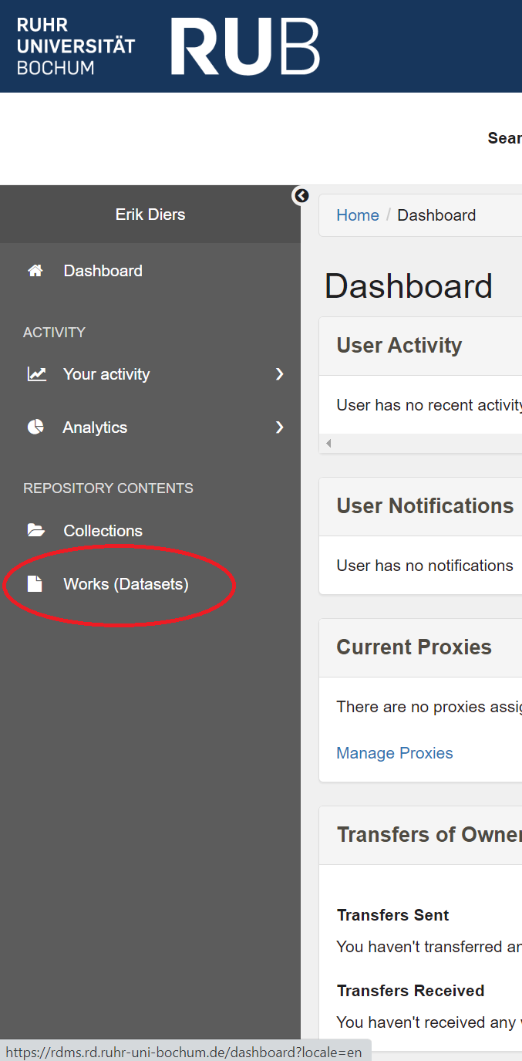
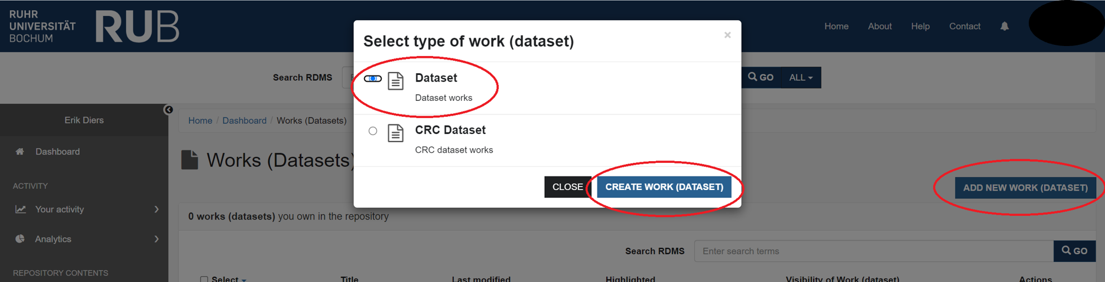
Add a new work
From your user dashboard, click “Works(Datasets)” in the grey sidebar on the left.
Click the blue button “ADD NEW WORK (DATASET)”.
A pop-up form is displayed, prompting you to choose a type of work you need.
Unless you are adding a work to a particular CRC collection, choose the option: “Dataset (Dataset works)”.
Then press the blue button: “CREATE WORK (DATASET)”.

Slide 11
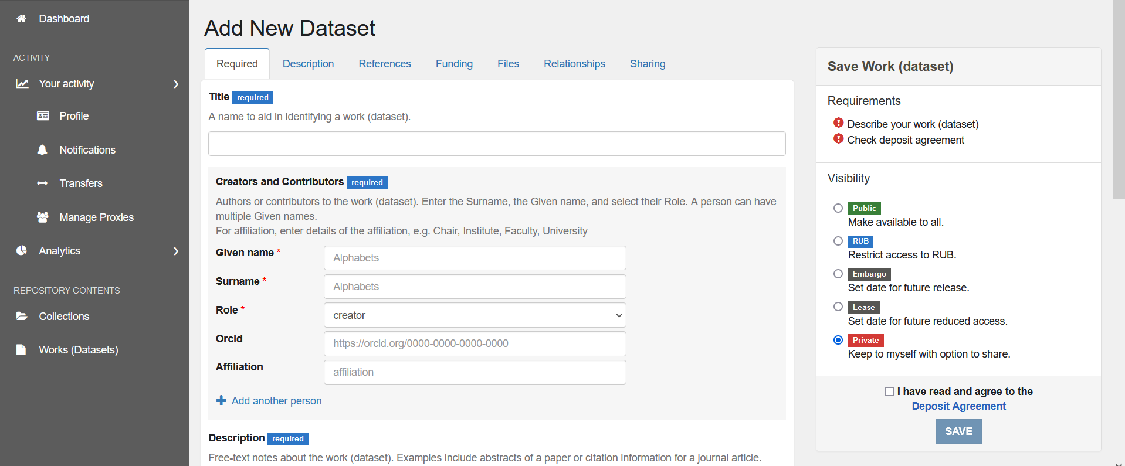
Add a new work
Fill in the “Add New Dataset” form.
Select a visibility option.
Tick the box next to the “Deposit Agreement” label.
Click on the black button “ADD FILES” and select files from your PC.
Finally, click on the blue “SAVE“button.

Slide 12
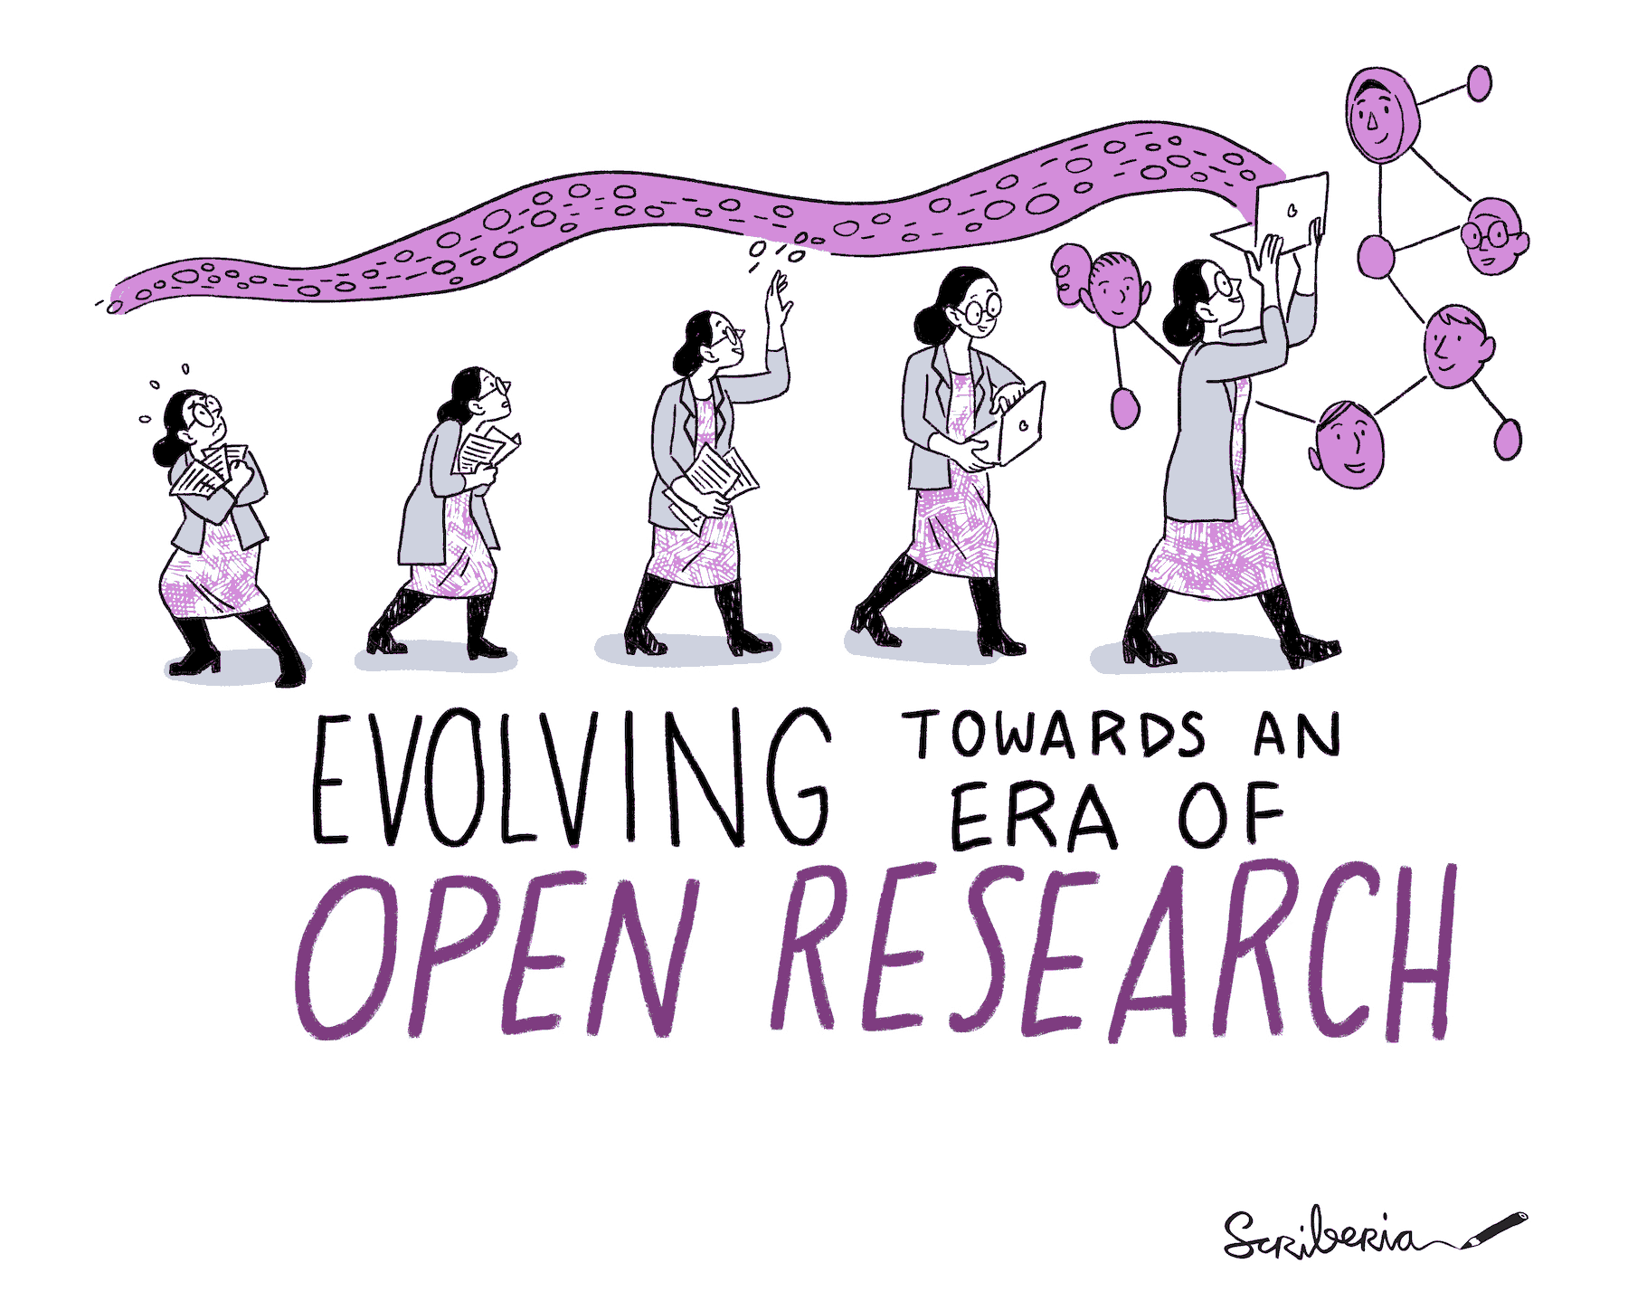
Hints:
When adding an ORCID identifier for a Creator or Contributor, you must use the full, web form of the ORCID, which looks like this: https://orcid.org/0000-0002-1825-0097
You may need to refresh the page to see the changes.
File selection: Please note that the maximum number of files for a single upload is 100 and the maximum upload size is 15 GB (gigabytes). For larger amounts and volumes of data, please contact us directly at researchdata@rub.de
Fig. 11 The Turing Way project illustration by Scriberia. Used under a CC-BY 4.0 licence. DOI: 10.5281/zenodo.3332807.

Slide 13
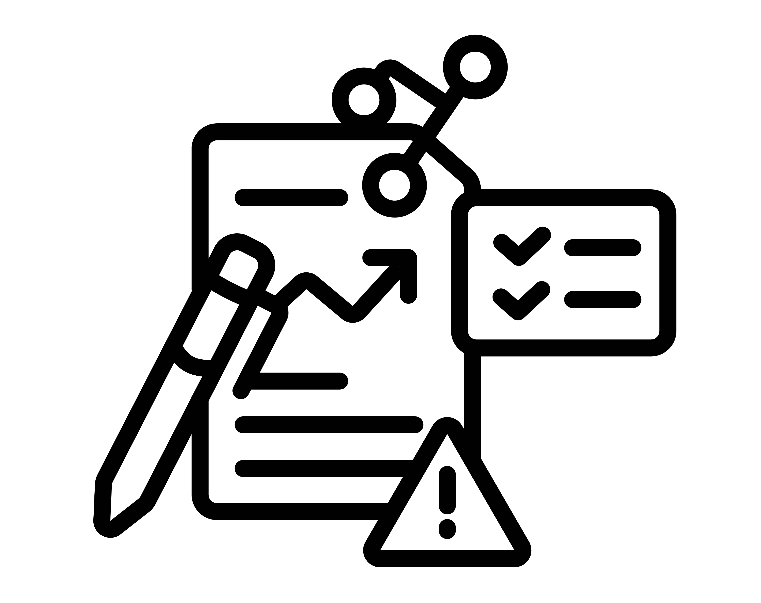
Viewing one of your works (datasets)
From your dashboard click on “Works (Dataset)” in the grey sidebar on the left to view your work.
Then click on the title of one of your datasets.

Slide 14
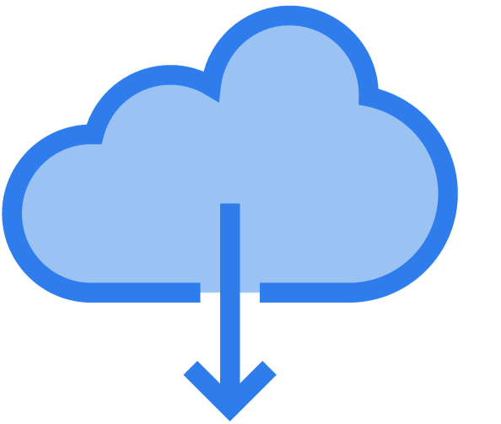
Download your work
When viewing one of your datasets, click on the black button "DOWNLOAD ALL". Allow the download if a pop-up window asks for it.
A ZIP file will be downloaded to your computer. This ZIP file contains a folder with all the files of the dataset, as well as the metadata file "metadata.json“ (ReSeeD metadata of the data set).

Slide 15
Add a work to a collection

Slide 16
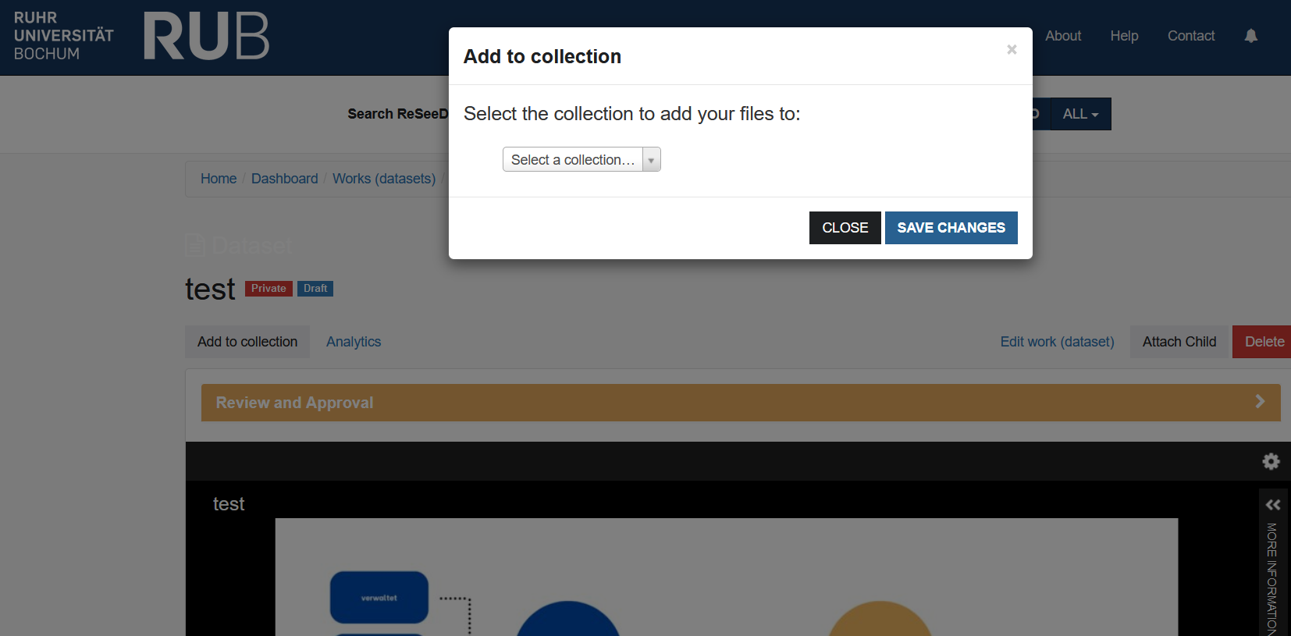
Add a work to a collection
While viewing one of your works, click on the grey button “Add to a collection”.
Choose a collection.
Click on “SAVE CHANGES”
The collection page is displayed, and your work (dataset) is now added to the list of works.

Slide 17
Search ReSeeD for datasets

Slide 18
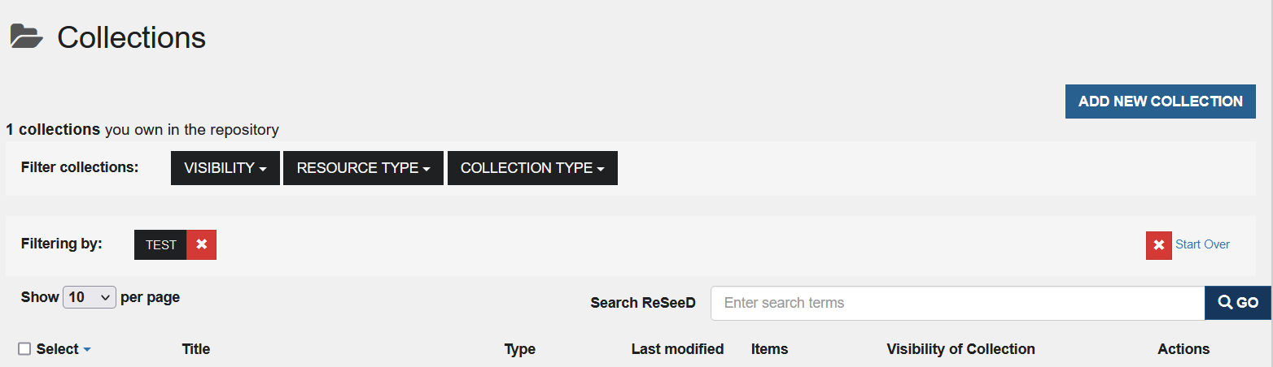
Search ReSeeD for datasets
With ReSeeD you can search in your own, shared or published datasets. If you are not logged in, you only have limited access.
Navigate to the ReSeeD-homepage.
Enter a search keyword / phrase in the “Search ReSeeD“ search box.
Filter option: the blue “drop-down” control on the right of the search box can be used to restrict your search to only your works or collections.
Finally, click on the “GO”- Button.

Slide 19
Search ReSeeD for datasets
The search criteria are indicated at the top of the search results page next to the label: “Filtering by:”
You can change the order of results by clicking the “Sort by relevance”. Or select a different criterion to sort the results: for example, by "Date uploaded".
Click on the "Start Over" button to deselect the old search criteria.

Slide 20
Publish a dataset
Archive a dataset

Slide 21
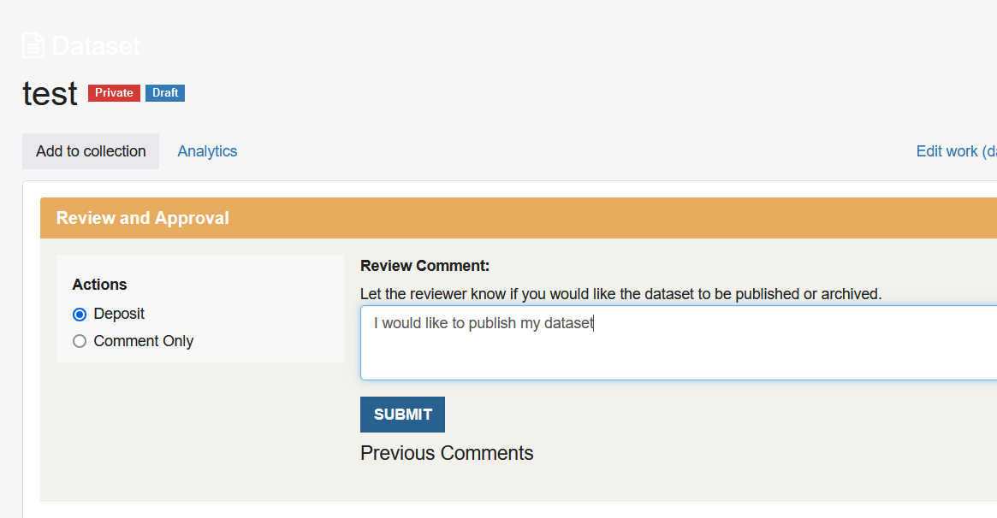
Publish your dataset with ReSeeD and obtain a DOI.
Publish a dataset
While viewing your work, open the Review and Approval panel.
Select “Deposit” from the available actions.
Add a comment to let the publication manager know that you would like your work to be published.
Click on the “SUBMIT” - button.

Slide 22

Archive a dataset
When viewing your work, open the Review and Approval panel.
Select "Deposit" from the available actions.
Add a comment to let the publication manager know that you would like your work to be archived.
Then click on the “SUBMIT”-button.
This dataset will now have the status "Pending review from publication manager". You will also see that you have received a new message (visible on the bell icon in the blue header bar at the top of the website). If you click on this icon, you will see a message informing you that your dataset has been submitted for review.

Slide 23
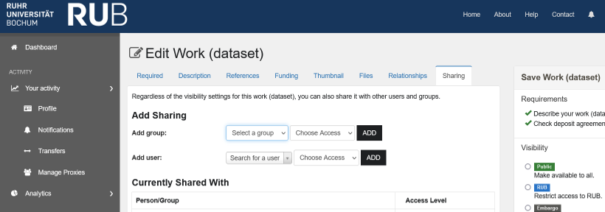
Optional functions

Slide 24



Optional functions
1. Relationships
The "Relationships" tab enables the assignment of a work to either an administrative set or a collection. Administrative users can add a work to any administrative set / collection within the repository. Regular users are restricted to adding works to collections they have initiated or those for which they possess the role of a depositor/manager .
2. Visibility
Visibility does not affect editing rights, but determines who can see your datasets.
3. Sharing
Add a person in the 'Add user' section by entering their RUB email address. Then set the access rights (view/download or edit).

Slide 25
Contact

Slide 26
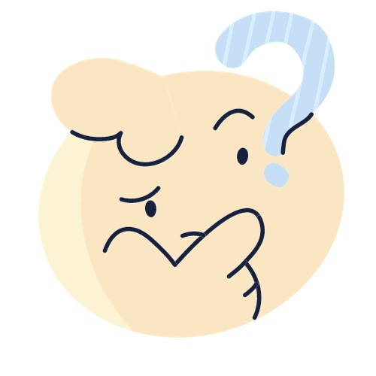


Services for research data
E-Mail: researchdata@ruhr-uni-bochum.de
Phone: +49 (0)234 32-24800
Mailing list on topic of research data
More information under https://www.ruhr-uni-bochum.de/researchdata/contact.html
Do you need help with ReSeeD?
Check out our FAQ Page or fill in our contact form directly in ReSeeD!
+

Slide 27
Image sources
Template: Peach Yellow Grid Mind Map Brainstorm template, by venicedesigns, published on Canva under Free Content License
Statistic icon: by Stockline on Canva, https://www.canva.com/icons/MAFaCyQte4A-statistic/
Illustrationen: Projekt „The Turing Way“, created by Scriberia with The Turing Way community. Used under CC-BY 4.0 license. DOI: 10.5281/zenodo.3332807
Screenshots: https://rdms.rd.ruhr-uni-bochum.de
Thoughtful expression: by iconsy, on Canva, https://www.canva.com/icons/MAD1osR0ZWA-emoji-thoughtful-expression-isolated-icon/
Order folder office: by texler on Pixabay, https://pixabay.com/illustrations/order-folder-office-sort-by-files-2398778/
Person using laptop icon: by sketchify on Canva, https://www.canva.com/icons/MAD0-1oZteA-person-using-laptop/
Person using latop icon: by sketchify on Canva, https://www.canva.com/icons/MAD0-22xHH4-person-using-laptop/

Slide 28
Image sources
View Files Icon: by Pillow Leaf on Canva, https://www.canva.com/icons/MAFMWSXEw_Q-view-files-icon/
Content Gradient Icon: by amethyststudio on Canva, https://www.canva.com/icons/MAEqsh2QXSA-content-gradient-icon/
Folder Glyph Icon: by Flowicon on Canva, https://www.canva.com/icons/MAEuw_14XOM-folder-glyph-icon/
Cloud Download Icon: by kmgdesignid on Canva, https://www.canva.com/icons/MAEmfIx-KKg-cloud-download-icon/

